Slide 1
Question 1

Slide 2
Introduction – Peer Performance Insights
Benchmarking ABC Fund : Insights from industry Peers
This presentation explores how ABC Fund compares to industry peers using return-based metrics.
We focus on metrics like rolling beta, R^2, cumulative returns, and the role of market dispersion.
The goal is to understand how our fund behaves differently, and when that matters most.

Slide 3
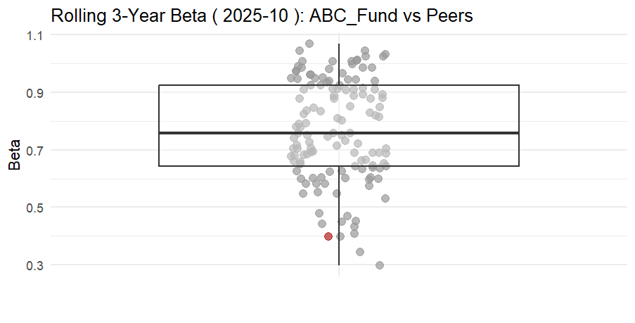
Rolling 3-Year Beta vs Peers
Market sensitivity : ABC’s Funds Beta in Context
The industry shows a wide range of betas, with peers clustering tightly around a beta of ~ 0.8
Our fund (ABC Fund) is well below industry median (~ 0.45) which highlights lower sensitivity to market movements.
ABC Fund is thus useful for clients seeking diversification or downside protection
This reinforces the idea that we are offering something other than just market exposure
Notes:
A funds beta measures its volatility in relation to the overall market, with a beta of 1.0 indicating it moves with the market.

Slide 4
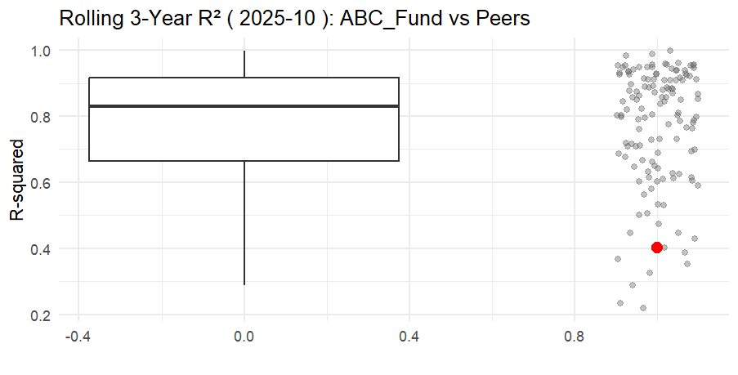
Rolling 3-Year R^2 vs Peers
Return Drivers : How differently does our fund behave ?
Our funds R^2 is well below that of most peers. This means it explains significantly less of its returns through traditional market factors.
This suggests that our strategy is more idiosyncratic, relying less on broad market moves and more on unique positions
A low R^2 isn’t necessary bad. It just reflects that we are doing something distinct which can be valuable in multi-manger portfolios
Notes:
R^2 reflects how much of a manager’s return is explained by market movements

Slide 5
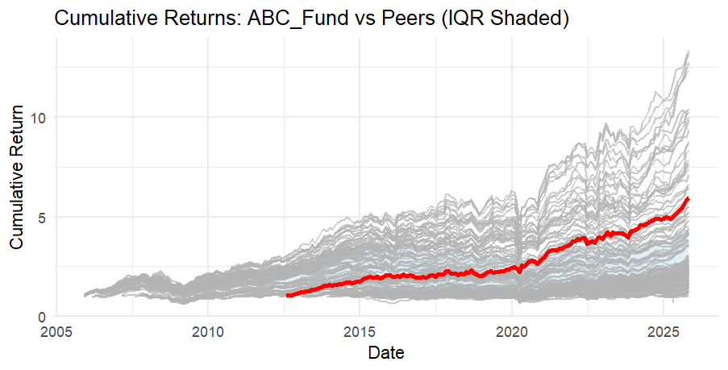
Cumulative Performance over Time
Cumulative returns : ABC Fund vs Peers (IQR Shaded)
Our fund has steadily outperformed the median peer over time. While peer performance varied, ABC Fund has delivered solid, consistent growth.
The red line shows ABC Fund’s cumulative return (consistently near upper quartile of peers)
The shaded band shows the middle 50% of peer outcomes (IQR). ABC Fund has stayed above it for most of the past decade.
This shows strong and consistent value-add, even through periods of market stress and dispersion.

Slide 6
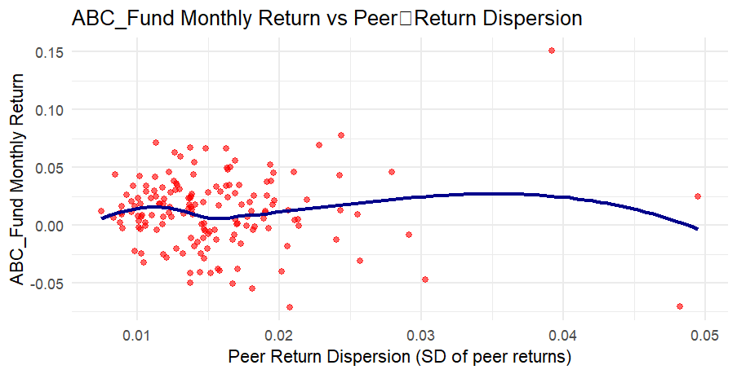
Dispersion and Performance
ABC Fund and Market Dispersion : Contrarian Edge?
Each point shows ABC Fund’s return vs how spread-out peers returns were that month .
There is a clear trend. We tend to perform better when peers are all over the place ( dispersion is high)
This could suggest contrarian value-add. Our approach shines brightest in uncertain or volatile environments
Despite this, returns are steady in low-dispersion periods too.
This shows that ABC Fund doesn’t just follow the crowd. We find opportunity when peers are all over the place.

Slide 7
Key Takeaways
Summary : Why ABC Fund stands out
Low Beta and R^2 : Our fund behaves differently from the pack
Strong long-term growth : Consistent outperformance vs peers
Contrarian edge : We shine most when others are scattered
The fund is not just different but reliably different : Perfect for portfolios

